Slide 1
Stack Overflow Developer Trends Report
Mehdi FIKRI
July 07, 2025

Slide 2
Outline
Executive Summary
Introduction
Methodology
Programming Languages Trends
Database Trends
Dashboards
Insights from Dashboard
Overall Findings and Implications
Conclusion
Appendix

Slide 3
Executive Summary
The project analyzes Stack Overflow survey data to reveal technology trends.
A combination of data cleaning, visualization, and dashboarding was used.
Key findings include the popularity of Python, JavaScript, PostgreSQL, and cloud tools.
Dashboards in Cognos and Looker Studio supported the analysis.
Implications suggest prioritizing cloud-native tools and hybrid database skills.

Slide 4
Introduction
This report explores global software development trends using Stack Overflow data.
Audience includes aspiring developers, educators, and tech recruiters.
Offers insights into language and database preferences, demographics, and future direction.
Adds value by guiding learning and hiring decisions in the tech industry.

Slide 5
Methodology
Data sourced from the 2024 Stack Overflow Developer Survey.
Cleaned data by removing nulls, standardizing formats, and parsing multi-select fields.
Used Python and pandas for analysis; Seaborn/Matplotlib for visualization.
Dashboards created in IBM Cognos and Looker Studio.
Focused on language/database trends, demographics, and platform usage.

Slide 6
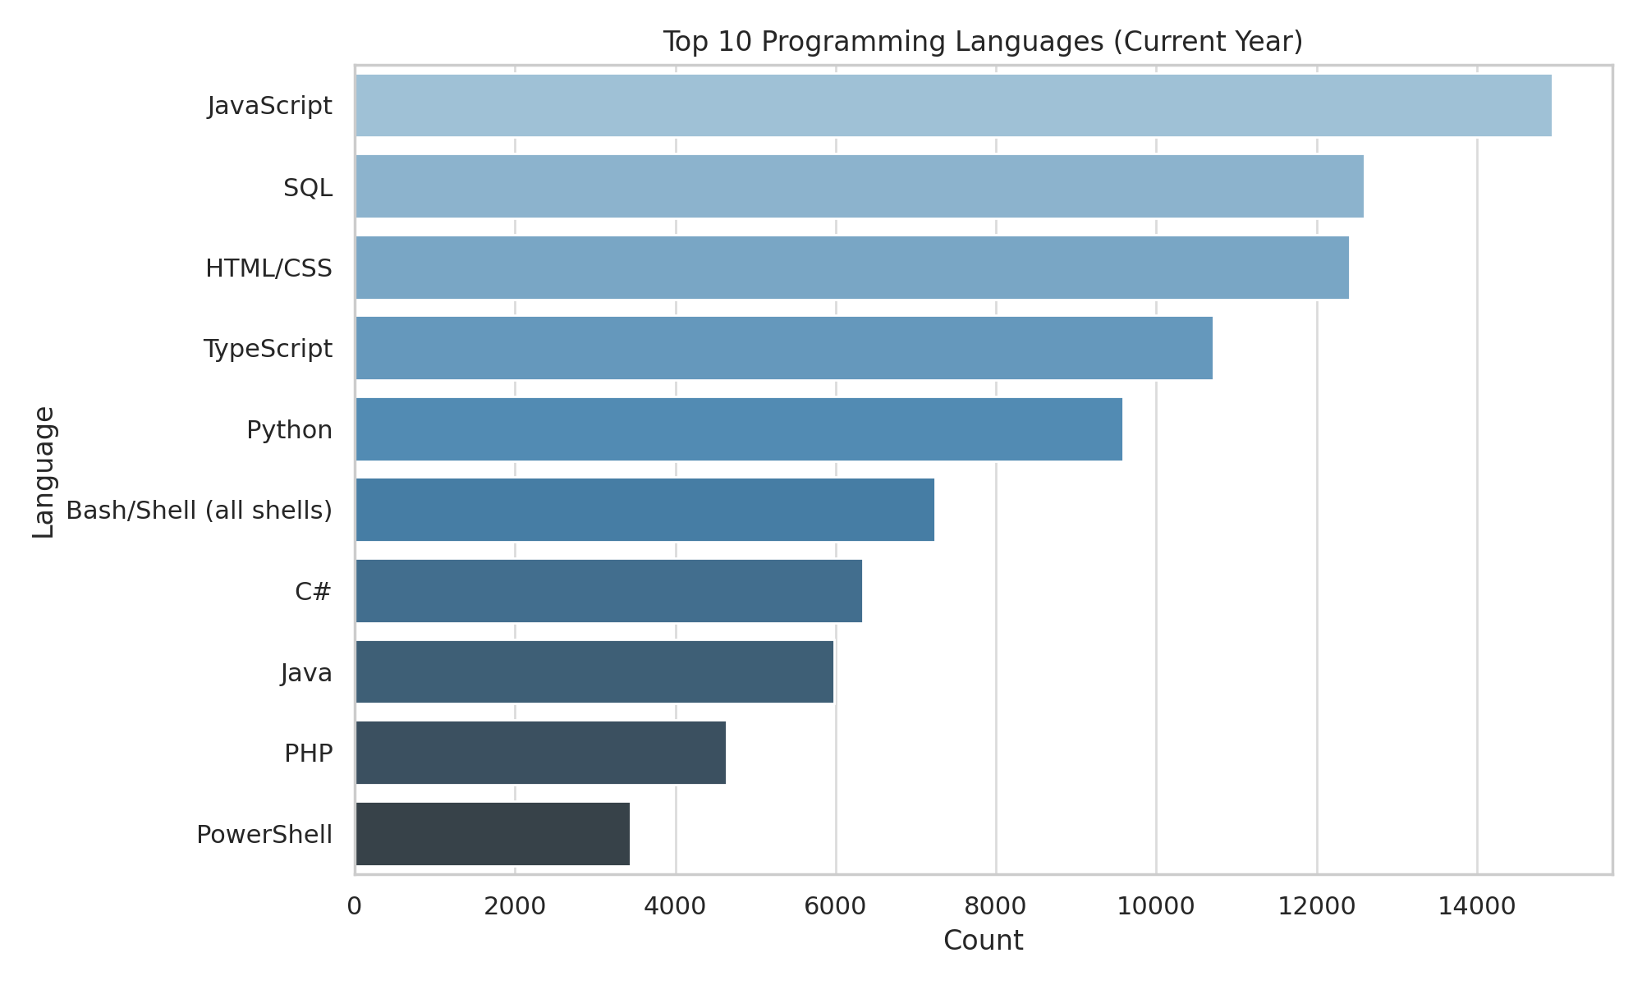
Top 10 Programming Languages (Current Year)

Slide 7
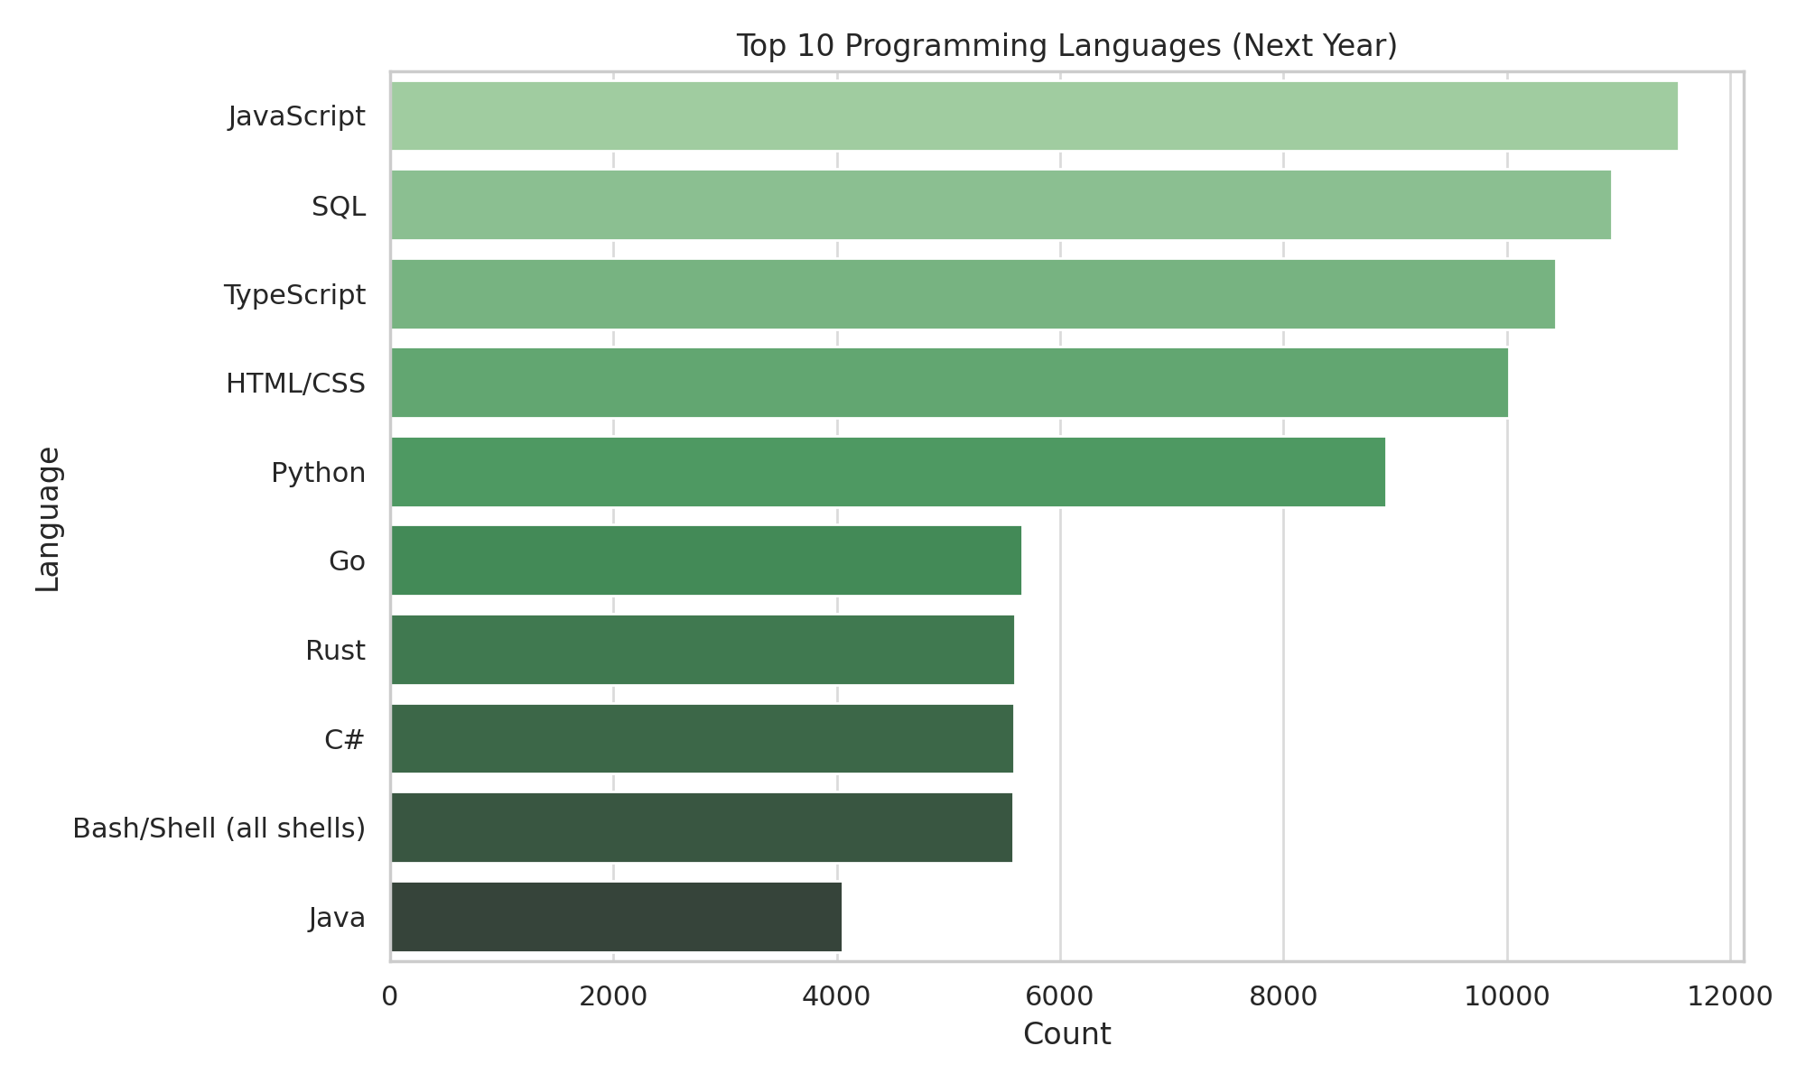
Top 10 Programming Languages (Next Year)

Slide 8
Programming Language Trends – Findings & Implications
Findings:
Most Used Now: JavaScript, HTML/CSS, SQL
Gaining Popularity: Python, TypeScript, C#
Declining: PowerShell, older C variants
Implications:
Learn Python, SQL, PostgreSQL — crucial for data and AI
JavaScript/TypeScript essential for web development
Modern apps demand MongoDB, Redis
Hybrid (SQL + NoSQL) and cloud systems are rising

Slide 9
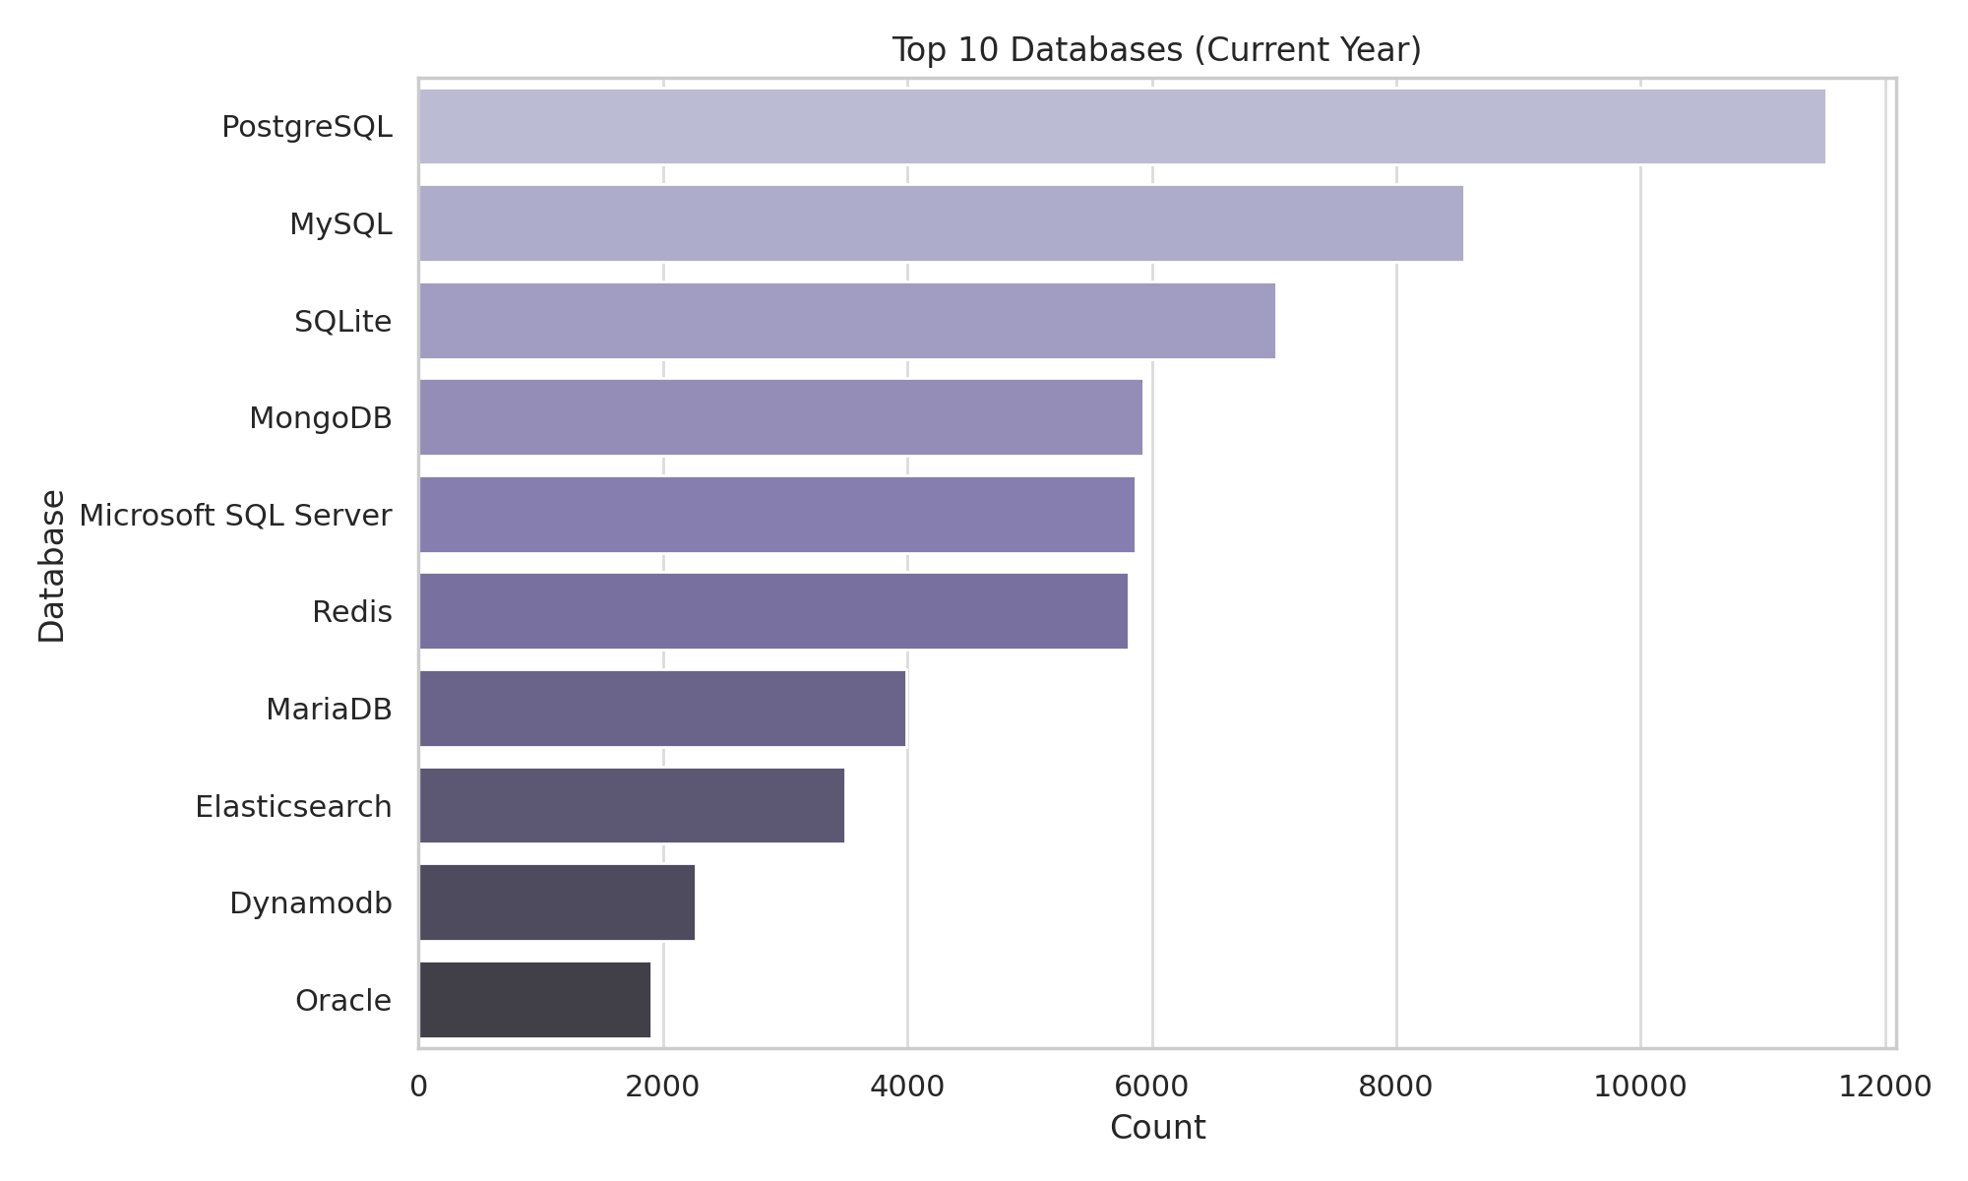
Top 10 Databases (Current Year)

Slide 10
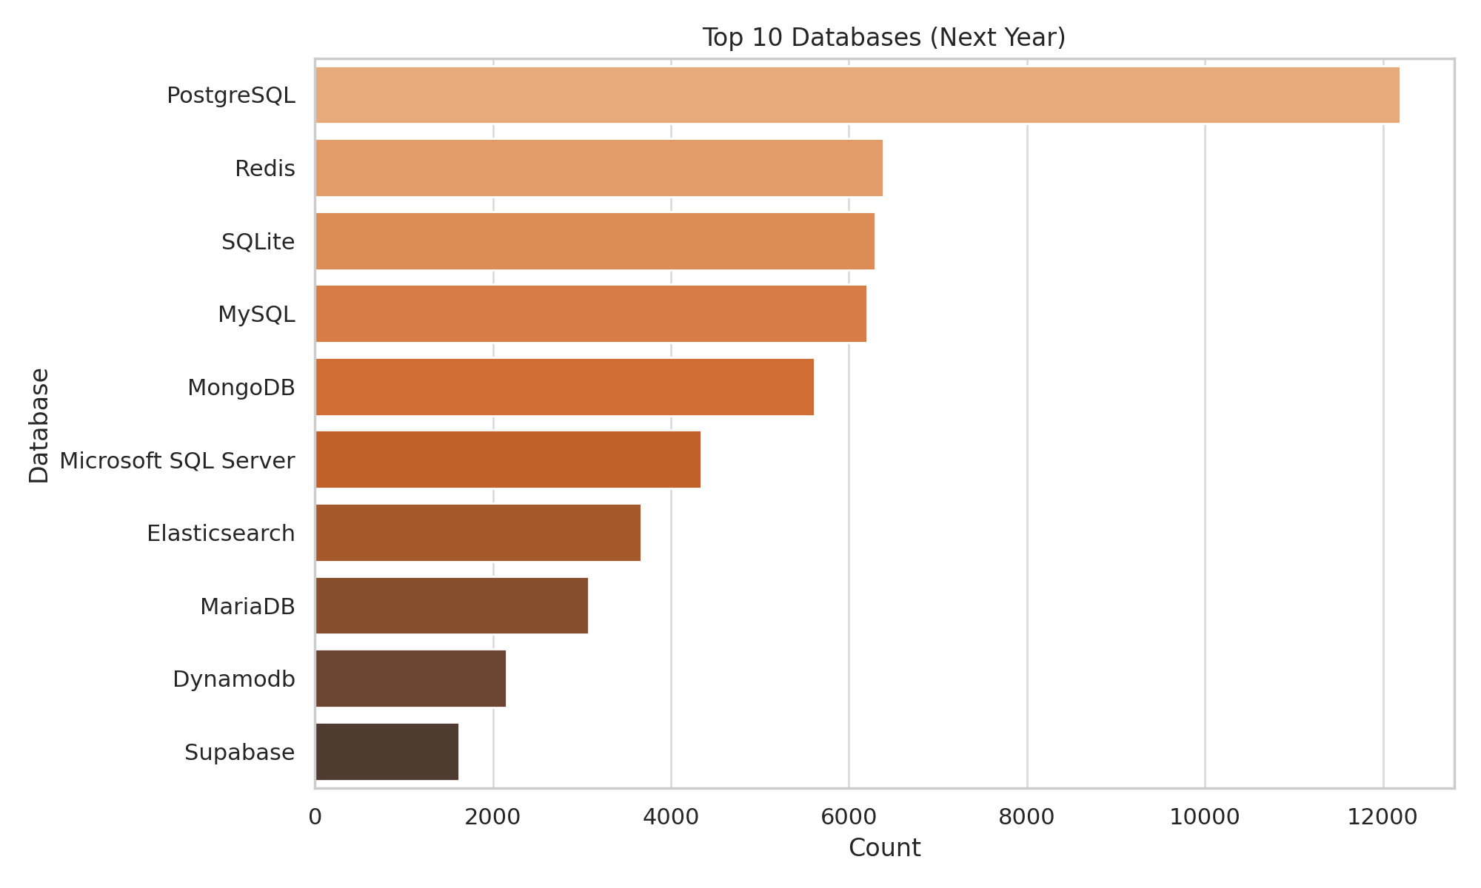
Top 10 Databases (Next Year)

Slide 11
Database Trends – Findings & Implications
Findings:
Leading DBs: PostgreSQL, MySQL, SQL Server
Growing DBs: SQLite, MongoDB
Hybrid SQL + NoSQL use increasing
Implications:
Master PostgreSQL and explore NoSQL options
Prepare for cloud-native and hybrid systems
Demand for scalable, distributed DBs is rising

Slide 12
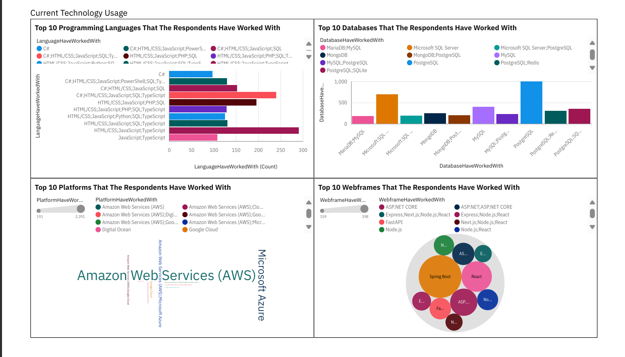
Dashboard: Current Technology Usage

Slide 13
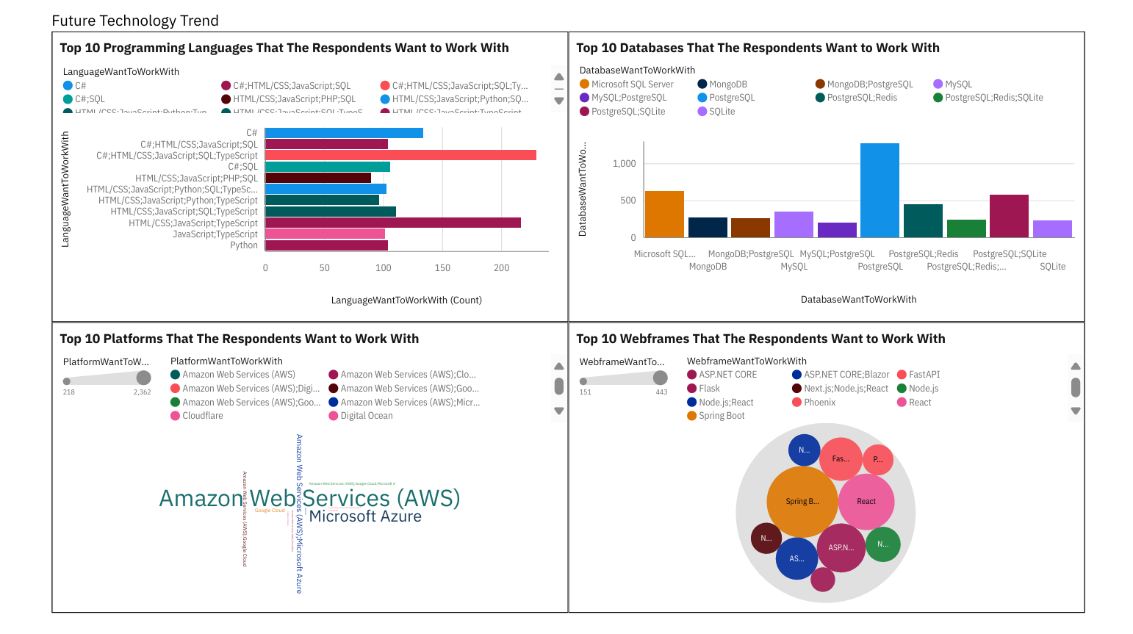
Dashboard: Future Technology Trends

Slide 14
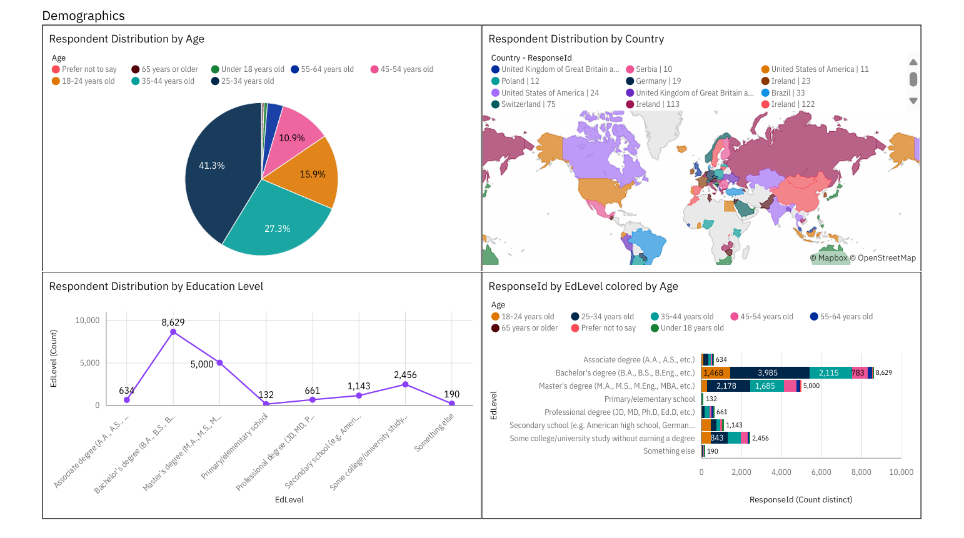
Dashboard: Demographics

Slide 15
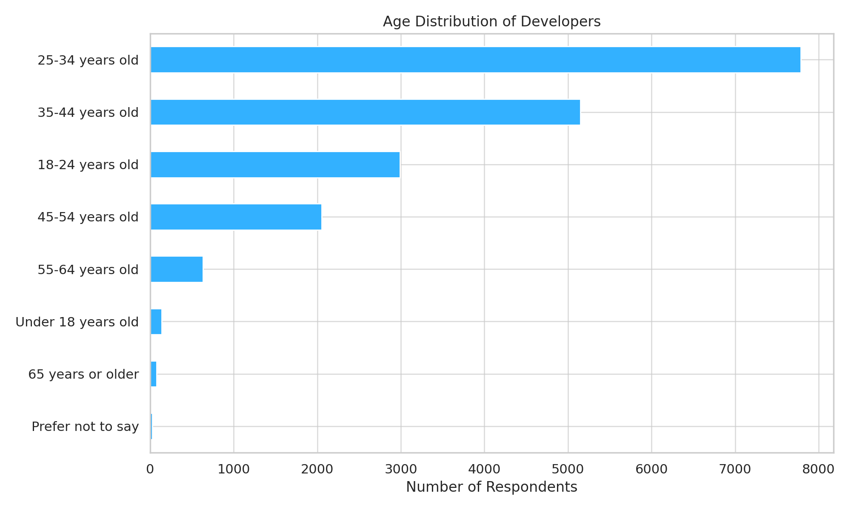
Developer Age Distribution

Slide 16
Insights from Dashboards
Python and JavaScript are universally dominant.
PostgreSQL leads in production; MongoDB rises in preference.
Most developers are aged 25-34; early-career stage dominates.
Strong shift toward hybrid and cloud-native stacks.
Majority are full-time employees; remote work is common.

Slide 17
Overall Findings and Implications
Findings:
Tech evolves rapidly; adaptability is key
• U.S. leads adoption and innovation
• Gender and age diversity gaps persist
Implications:
Lifelong learning is essential for devs
Broaden access to tools and education globally
Employers must prioritize inclusive hiring

Slide 18
Conclusion
Reveals global dev trends across tools, languages, and roles
Strong links between tech skills and salaries
Highlights diversity and accessibility challenges
Empowers devs and orgs to align with future tech shifts

Slide 19
Appendix: Extra Chart – Future Language Demand

